Slide 1

Chapter 2.2 Similarity Measures

Slide 2
Similarity Measure
Similarity obeys three intuitions
S1: the more commonality two objects share, the more similar they are;
S2: the more differences two objects have, the less similar they are;
S3: the maximum similarity is reached when two objects are identical, no matter how much commonality they share.
Dekang Lin. An information-theoretic definition of similarity. In Proceedings of the 15th International Conference on Machine Learning, 98 of ICML, pages 296-304, 1998

Slide 3
Survey Papers
S.H. Cha. Comprehensive survey on distance/similarity measures between probability density functions. City, 1(2):1, 2007.
Padraig Cunningham. A taxonomy of similarity mechanisms for case-based reasoning. IEEE Transactions on Knowledge and Data Engineering, 21(11):1532-1543, 2009.

Slide 4
Outline
Commonly used measures
Pearson Correlation Coefficient (PCC)
Cosine Similarity (COS)
Correlation Analysis
More similarity measures
Distance-based Similarities
Set-based Similarities
Link-based Similarites
Bayesian Similarity

Slide 5
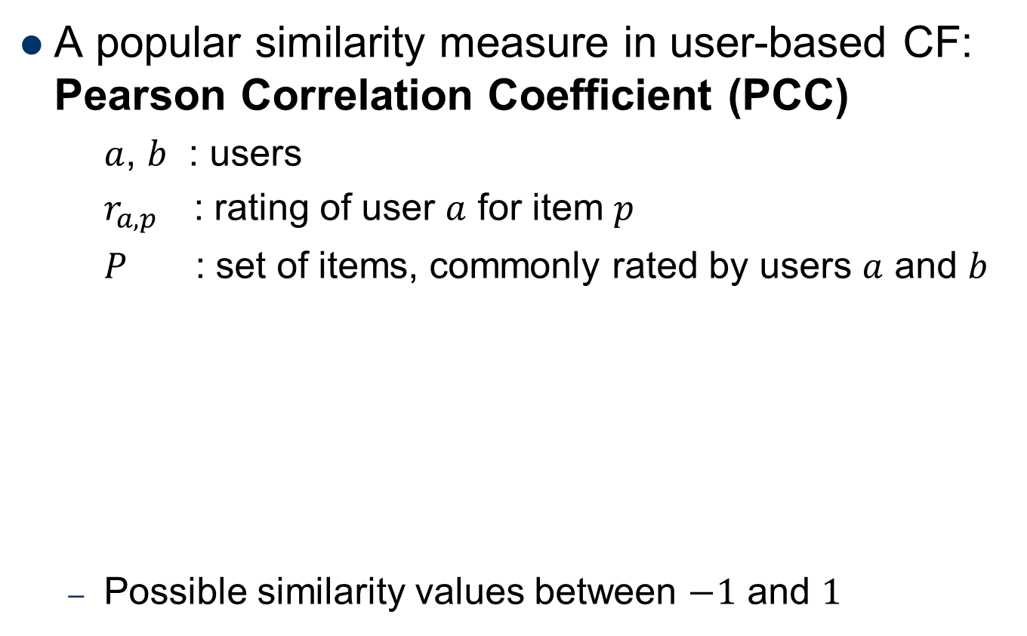
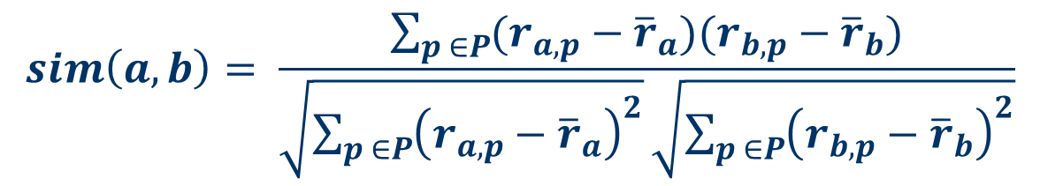
Pearson Correlation Coefficient
A popular similarity measure in user-based CF: Pearson Correlation Coefficient (PCC)
$a$, $b$ : users
$r_{a,p}$ : rating of user $a$ for item $p$
$P$ : set of items, commonly rated by users $a$ and $b$
Possible similarity values between $−1$ and $1$
$$sim\left(a,b\right)= \frac{\sum_{p ∈P}{(r_{a,p}−{\overline{r}}_{a})(r_{b,p}−{\overline{r}}_{b})}}{\sqrt{\sum_{p ∈P}{{\left(r_{a,p}−{\overline{r}}_{a}\right)}^{2}}}\sqrt{\sum_{p ∈P}{{\left(r_{b,p}−{\overline{r}}_{b}\right)}^{2}}}}$$
Notes:
Explain the meanings of similarity value, -1: dissimilar; 1: similar; 0: uncorrelated.

Slide 6
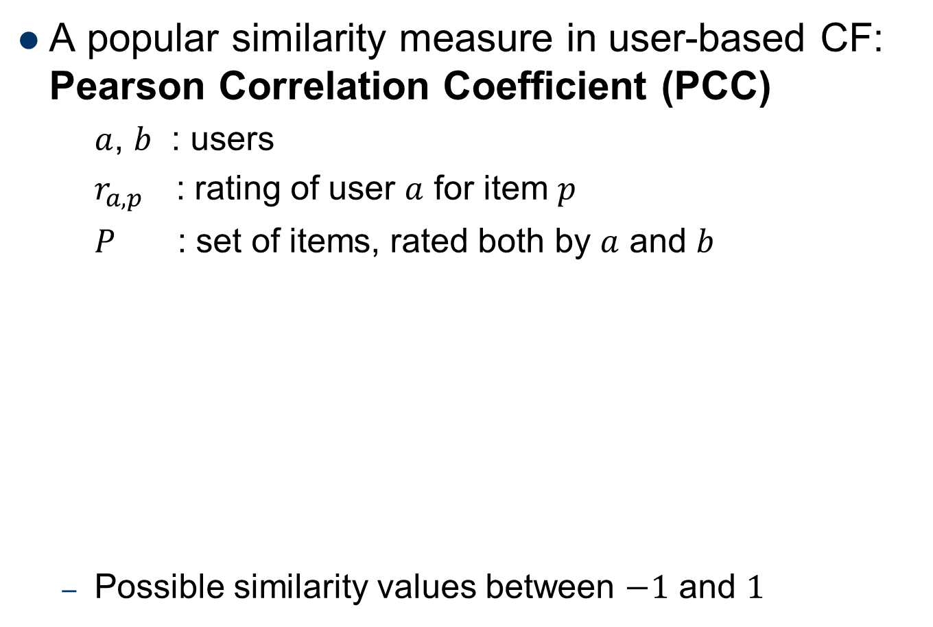
PCC Example
A popular similarity measure in user-based CF: Pearson Correlation Coefficient (PCC)
$a$, $b$ : users
$r_{a,p}$ : rating of user $a$ for item $p$
$P$ : set of items, rated both by $a$ and $b$
Possible similarity values between $−1$ and $1$
 | Item1 | Item2 | Item3 | Item4 | Item5
Alice | 5 | 3 | 4 | 4 | ?
User1 | 3 | 1 | 2 | 3 | 3
User2 | 4 | 3 | 4 | 3 | 5
User3 | 3 | 3 | 1 | 5 | 4
User4 | 1 | 5 | 5 | 2 | 1
sim = 0.853
sim = 0.707
sim = 0.000
sim = -0.792
Notes:
Invoke CORREL(col1, col2) in Excel to compute PCC values.
Ask Questions regarding the comparisons/explanations about the four similarity values.

Slide 7
Similarity Illustration
PCC considers differences in rating behavior
Works well in usual domains, compared with alternative measures
such as cosine similarity

Slide 8
PCC based on overlappings
 | Item1 | Item2 | Item3 | Item4 | Item5
Alice | 5 | 0 | 4 | 4 | ?
User1 | 3 | 1 | 0 | 3 | 3
User2 | 4 | 0 | 4 | 3 | 5
User3 | 0 | 3 | 1 | 5 | 4
User4 | 1 | 5 | 5 | 0 | 1
sim = NaN
sim = 1.0
sim = NaN
sim = -1.0
Remarks
Similarity operation on commonly rated items
Value 0 indicates unavailable rating
Value of number of co-rated items
Use "significance weighting", by e.g., linearly reducing the weight when the number of co-rated items is low

Slide 9
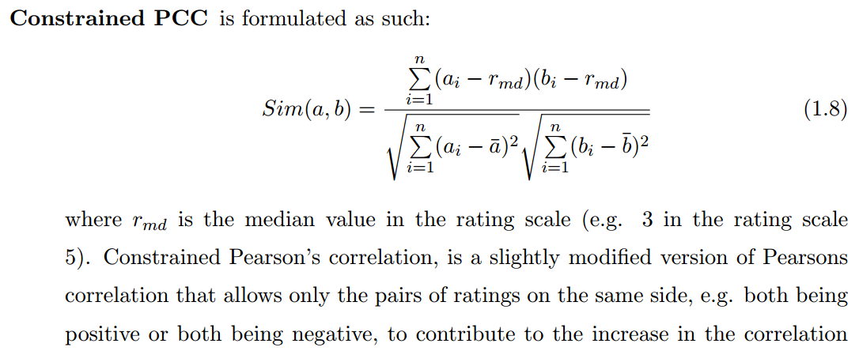
Constrained PCC

Slide 10
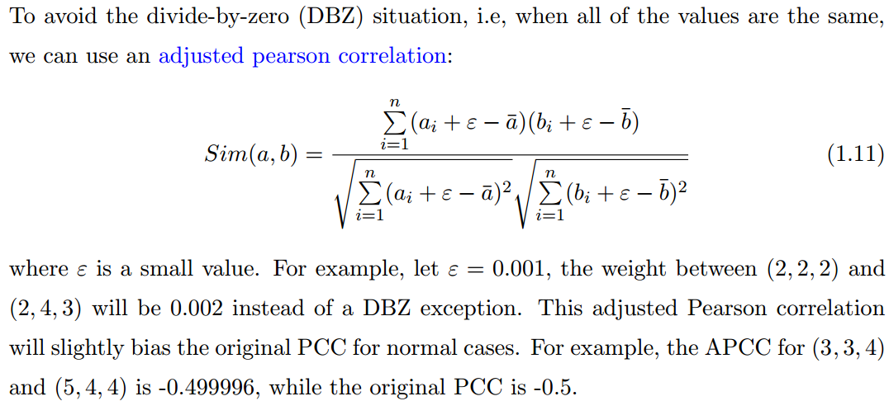
Adjusted PCC
Notes:
Su et al. [88] use the APCC only for the divided-by-zero cases and otherwise use the original PCC because their empirical results show that this strategy performs better than solely using the original PCC, or solely using the APCC.

Slide 11
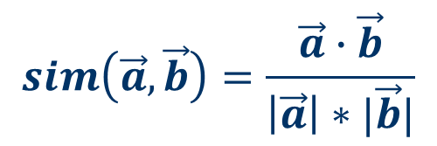
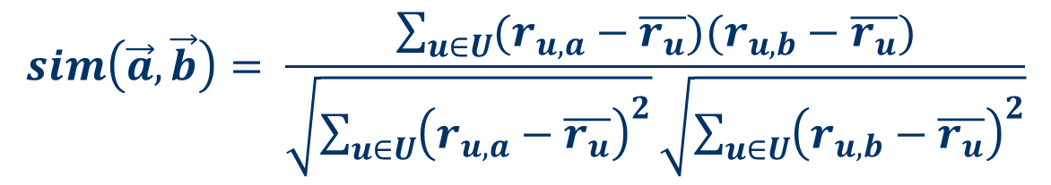
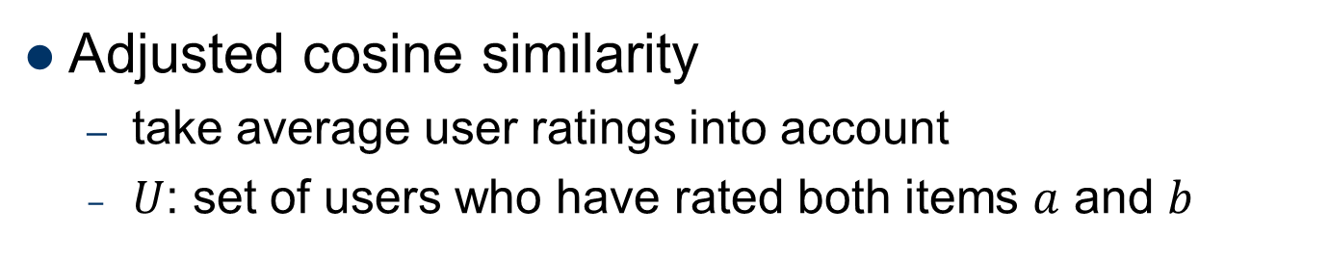
Cosine similarity
Produces better results in item-based CF
Cosine similarity is calculated based on the angle between the rating vectors
$$sim\left(\vec{a},\vec{b}\right)=\frac{\vec{a}∙\vec{b}}{\left|\vec{a}\right|∗|\vec{b}|}$$
Adjusted cosine similarity
take average user ratings into account
$U$: set of users who have rated both items $a$ and $b$
$$sim\left(\vec{a},\vec{b}\right)= \frac{\sum_{u∈U}{(r_{u,a}−\overline{r_{u}})(r_{u,b}−\overline{r_{u}})}}{\sqrt{\sum_{u∈U}{{\left(r_{u,a}−\overline{r_{u}}\right)}^{2}}}\sqrt{\sum_{u∈U}{{\left(r_{u,b}−\overline{r_{u}}\right)}^{2}}}}$$

Slide 12
Correlation Analysis
Introduction to correlation
Calculation of correlation
Properties of correlation

Slide 13
Correlation: Bivariate Relationships
A correlation describes a relationship between two variables, e.g. (GPA, SAT score)
Correlation tries to answer the following questions:
What is the relationship between variables X and Y?
Linear? How closely data points follow a straight line?
How are the scores on one measure associated with scores on anther measure?
Changing trends, not necessary due to causation
To what extent do the high scores on one variable go with the high scores on the second variable?
Changing magnitude

Slide 14
Cases of Correlations
Measures of same individuals on two variables
X: a set of GPA scores
Y: a set of SAT scores
Measures of different individuals on the “same” variable
X: a set of GPA scores by Chinese students
Y: a set of GPA scores by Singaporean students
or
X: stock A’s price
Y: stock B’s price

Slide 15
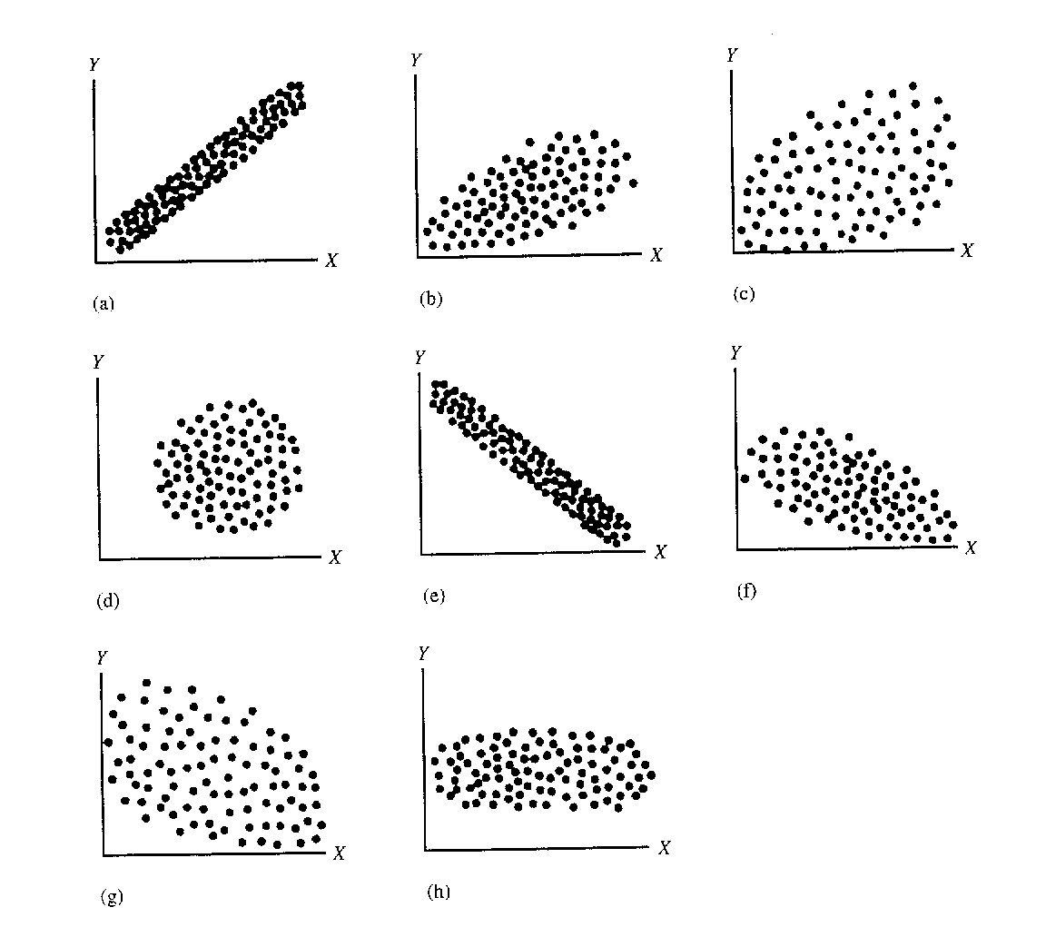
Illustration by Scatter Plots
(i)
Notes:
(h): no correlation between X and Y.
+ Q: Why doesn’t a tight fit to a horizontal line imply a strong correlation?
+ A: No matter how X changes, Y doesn’t change at all. No correlation at all.
(i): not linear relationship between X and Y, correlation r = 0;

Slide 16
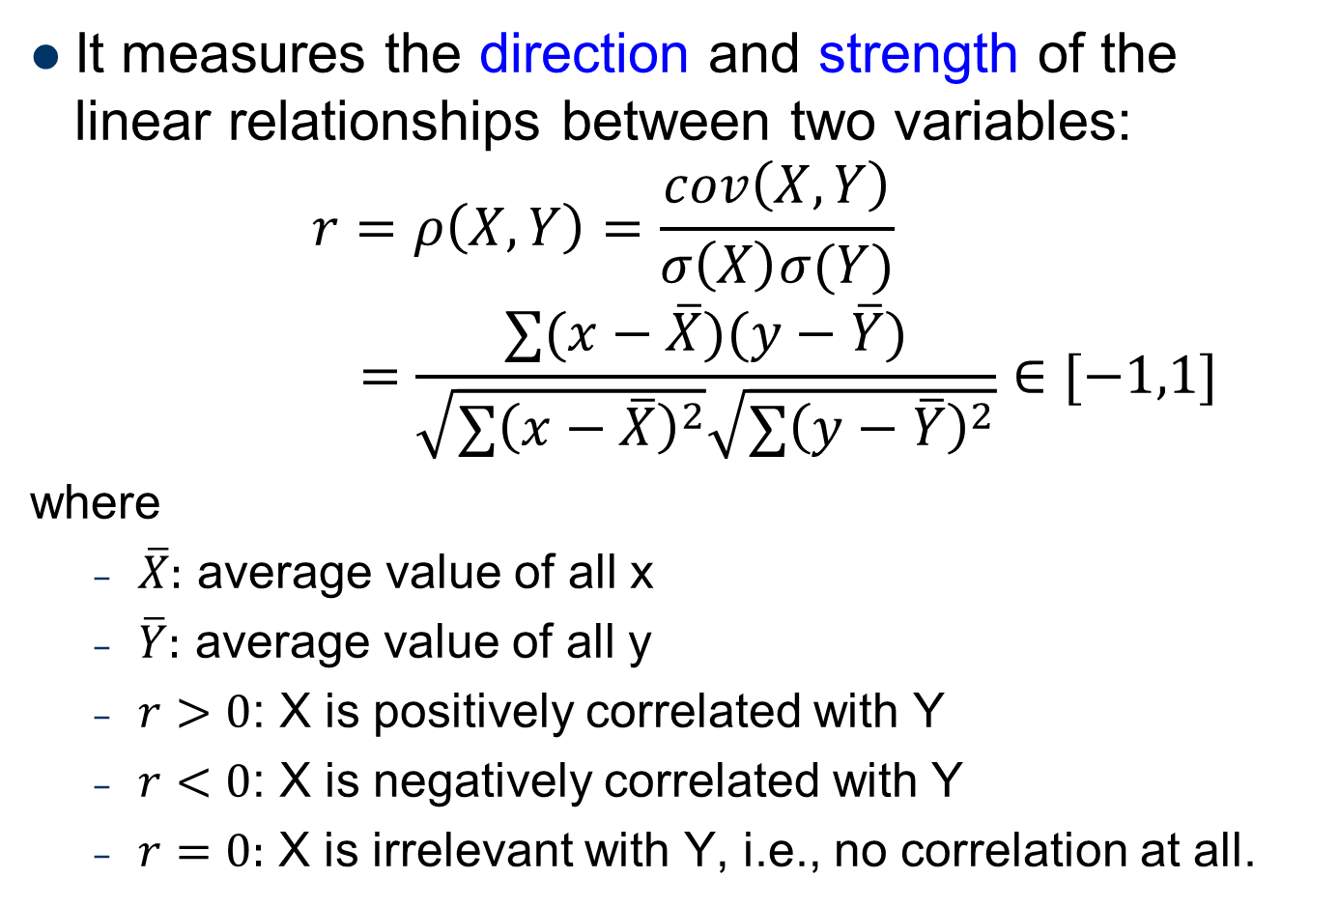
Pearson correlation coefficient
It measures the direction and strength of the linear relationships between two variables:
$$r=ρ\left(X, Y\right)=\frac{cov\left(X,Y\right)}{σ\left(X\right)σ(Y)}$$
$$=\frac{∑(x−\overline{X})(y−\overline{Y})}{\sqrt{∑{\left(x−\overline{X}\right)}^{2}}\sqrt{∑{\left(y−\overline{Y}\right)}^{2}}}∈[−1,1]$$
where
$\overline{X}:$ average value of all x
$\overline{Y}:$ average value of all y
$r>0$: X is positively correlated with Y
$r<0$: X is negatively correlated with Y
$r=0:$ X is irrelevant with Y, i.e., no correlation at all.

Slide 17

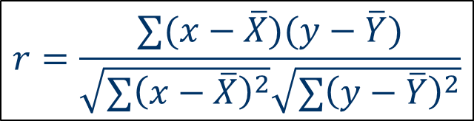
PCC: an Example
Try it yourself:
X | Y
8 | 10
7 | 8
3 | 2
5 | 6
7 | 9
2 | 2
4 | 5
$$r=\frac{∑(x−\overline{X})(y−\overline{Y})}{\sqrt{∑{\left(x−\overline{X}\right)}^{2}}\sqrt{∑{\left(y−\overline{Y}\right)}^{2}}}$$
The correlation is $r=?$

Slide 18
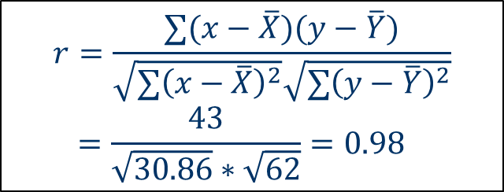
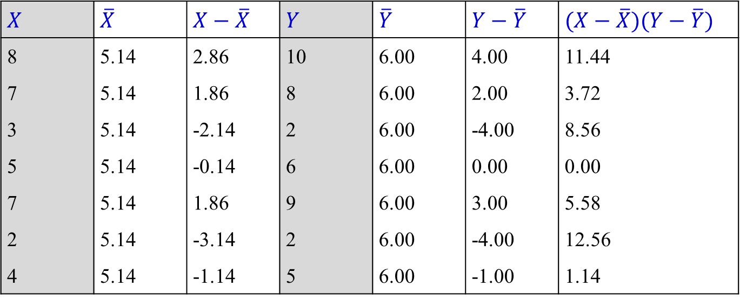



PCC: an Example (2)
$$X$$ | $$\overline{X}$$ | $$X−\overline{X}$$ | $$Y$$ | $$\overline{Y}$$ | $$Y−\overline{Y}$$ | $$(X−\overline{X})(Y−\overline{Y})$$
8 | 5.14 | 2.86 | 10 | 6.00 | 4.00 | 11.44
7 | 5.14 | 1.86 | 8 | 6.00 | 2.00 | 3.72
3 | 5.14 | -2.14 | 2 | 6.00 | -4.00 | 8.56
5 | 5.14 | -0.14 | 6 | 6.00 | 0.00 | 0.00
7 | 5.14 | 1.86 | 9 | 6.00 | 3.00 | 5.58
2 | 5.14 | -3.14 | 2 | 6.00 | -4.00 | 12.56
4 | 5.14 | -1.14 | 5 | 6.00 | -1.00 | 1.14
$$∑\left(X−\overline{X}\right)\left(Y−\overline{Y}\right)=43$$
$$r=\frac{∑(x−\overline{X})(y−\overline{Y})}{\sqrt{∑{\left(x−\overline{X}\right)}^{2}}\sqrt{∑{\left(y−\overline{Y}\right)}^{2}}}$$
$$=\frac{43}{\sqrt{30.86}∗\sqrt{62}}=0.98$$
$$∑{\left(X−\overline{X}\right)}^{2}=30.86$$
$$∑{\left(Y−\overline{Y}\right)}^{2}=62$$
Notes:
Try to verify it by Excel function: correl(array1, array2)

Slide 19
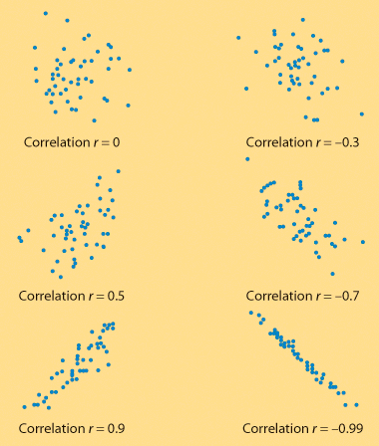
Properties of Correlation
Strength:
how closely the data points follow a straight line
Direction:
is positive when individuals with higher X values tend to have higher values of Y.

Slide 20
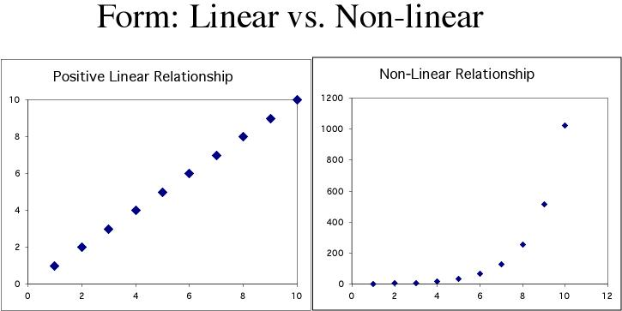
Properties of Correlation (2)
Correlation only describes linear relationship
No matter how strong the association, correlation does not describe non-linear relationship, such as the curved relationship.
Notes:
Q: how can we apply correlation to non-linear cases?
A: You can sometimes transform a non-linear association to a linear form, for instance by taking the logarithm. You can then calculate a correlation using the transformed data. That is, y = 2^x => log y = x * log 2 => calculate the correlation： r(logy, x)

Slide 21
Spearman’s Correlation Coefficient
It is used for ordinal variables.
When a non-linear, monotonically increasing or decreasing function describes the relation between X and Y, we can convert the continuous variables to ranks (ordinal variables) to get linear relationship between X and Y.
With X and Y’s rank scores, Spearman’s correlation coefficient (SCC) can be computed with the formula of Pearson correlation coefficient (PCC).
Notes:
The SRCC is simply a special case of PCC in which two sets of two variables are converted to ranking two variables before calculating the coefficient.

Slide 22
SCC: an Example
Try it yourself:
X | Rank(X) | Y | Rank(Y)
1 |  | 4
1 |  | 8
2 |  | 10
3 |  | 14
4 |  | 15
5 |  | 16
6 |  | 17
7 |  | 18
8 |  | 18
$$r=\frac{∑(x−\overline{X})(y−\overline{Y})}{\sqrt{∑{\left(x−\overline{X}\right)}^{2}}\sqrt{∑{\left(y−\overline{Y}\right)}^{2}}}$$
The correlation is $r=?$

Slide 23

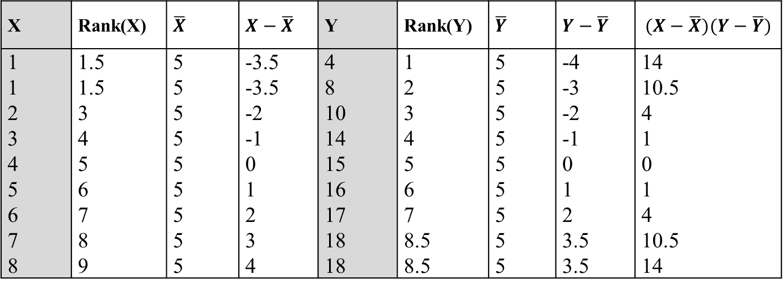
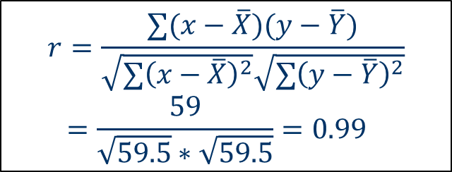


SCC: an Example (2)
X | Rank(X) | $$\overline{X}$$ | $$X−\overline{X}$$ | Y | Rank(Y) | $$\overline{Y}$$ | $$Y−\overline{Y}$$ | $$(X−\overline{X})(Y−\overline{Y})$$
1 | 1.5 | 5 | -3.5 | 4 | 1 | 5 | -4 | 14
1 | 1.5 | 5 | -3.5 | 8 | 2 | 5 | -3 | 10.5
2 | 3 | 5 | -2 | 10 | 3 | 5 | -2 | 4
3 | 4 | 5 | -1 | 14 | 4 | 5 | -1 | 1
4 | 5 | 5 | 0 | 15 | 5 | 5 | 0 | 0
5 | 6 | 5 | 1 | 16 | 6 | 5 | 1 | 1
6 | 7 | 5 | 2 | 17 | 7 | 5 | 2 | 4
7 | 8 | 5 | 3 | 18 | 8.5 | 5 | 3.5 | 10.5
8 | 9 | 5 | 4 | 18 | 8.5 | 5 | 3.5 | 14
$$∑\left(X−\overline{X}\right)\left(Y−\overline{Y}\right)=59$$
$$r=\frac{∑(x−\overline{X})(y−\overline{Y})}{\sqrt{∑{\left(x−\overline{X}\right)}^{2}}\sqrt{∑{\left(y−\overline{Y}\right)}^{2}}}$$
$$=\frac{59}{\sqrt{59.5}∗\sqrt{59.5}}=0.99$$
$$∑{\left(X−\overline{X}\right)}^{2}=59.5$$
$$∑{\left(Y−\overline{Y}\right)}^{2}=59.5$$

Slide 24
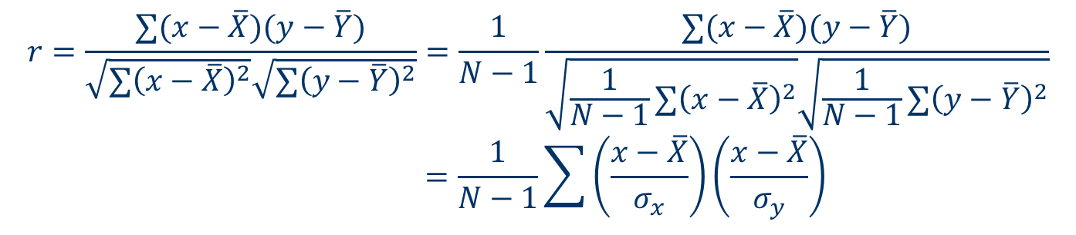
Properties of Correlation (3)
Has no unit
Changing the unit of variables does not change the correlation coefficient, because we get rid of all our units when we standard (get z-scores)
$$r=\frac{∑(x−\overline{X})(y−\overline{Y})}{\sqrt{∑{\left(x−\overline{X}\right)}^{2}}\sqrt{∑{\left(y−\overline{Y}\right)}^{2}}}=\frac{1}{N−1}\frac{∑(x−\overline{X})(y−\overline{Y})}{\sqrt{\frac{1}{N−1}∑{\left(x−\overline{X}\right)}^{2}}\sqrt{\frac{1}{N−1}∑{\left(y−\overline{Y}\right)}^{2}}}$$
$$=\frac{1}{N−1}\sum{\left(\frac{x−\overline{X}}{σ_{x}}\right)\left(\frac{x−\overline{X}}{σ_{y}}\right)}$$
data standardization
Notes:
Why N-1? Because 1 degree of freedom was used to calculate the means.

Slide 25
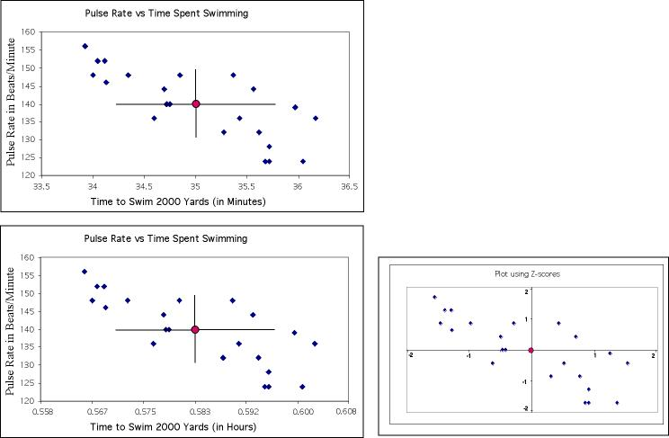
z-score plot is the same for both plots
Standardization:
Allows us to compare the correlations where variables are measured in different units or when variables are different
r = -0.75
r = -0.75
Notes:
For example, we can compare the correlations between [Height and Weight] and [Height and Age]

Slide 26
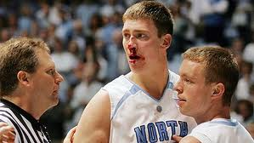

Properties of Correlation (4)
High correlation does not imply causation
x = fouls committed by a player;
y = points scored by the same player
(1,2) (24,75) (1,0) (18,59) (9,9) (3,7) (5,35) (20,46) (1,0) (3,2) (22,57)
$r$ measures the strength of the linear relationship between x and y; it does not indicate cause and effect
correlation
$r=0.935$
The correlation is due to a third “lurking” variable – playing time

Slide 27
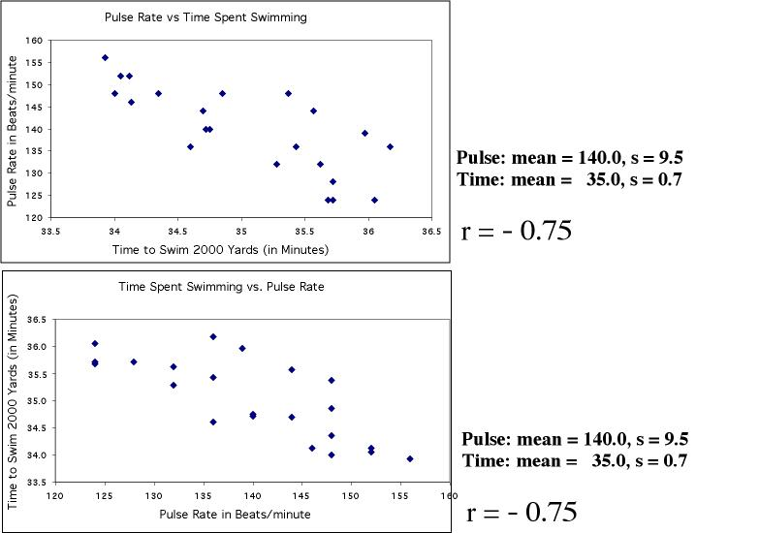
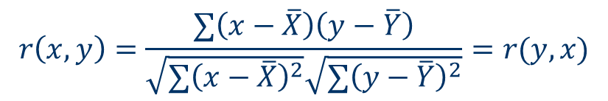

Properties of Correlation (5)
$r\left(x, y\right)=r(y, x)$：does not distinguish x from y
$$r\left(x,y\right)=\frac{∑\left(x−\overline{X}\right)\left(y−\overline{Y}\right)}{\sqrt{∑{\left(x−\overline{X}\right)}^{2}}\sqrt{∑{\left(y−\overline{Y}\right)}^{2}}}=r(y, x)$$
r = -0.75
r = -0.75
"Time to swim" is the explanatory variable here, and belongs on the x axis. However, in either plot r is the same (r=-0.75).

Slide 28
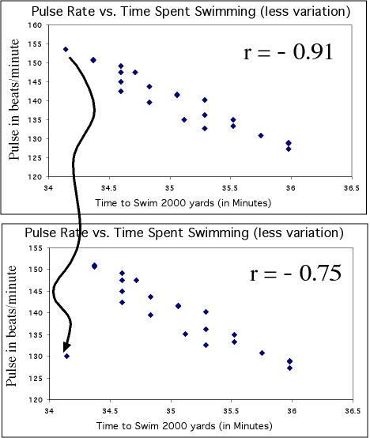
Properties of Correlation (6)
Correlations are calculated using means and standard deviations, and thus are NOT resistant to outliers
Just moving one point away from the general trend here decreases the correlation from -0.91 to -0.75

Slide 29
Properties (Summary)
Correlation
Is a measure of the direction and strength of the linear relationship between X and Y
Has no unit
Ranges in [-1, 1]
Does not imply causation
Does not distinguish between X and Y
Can be affected by outliers

Slide 30
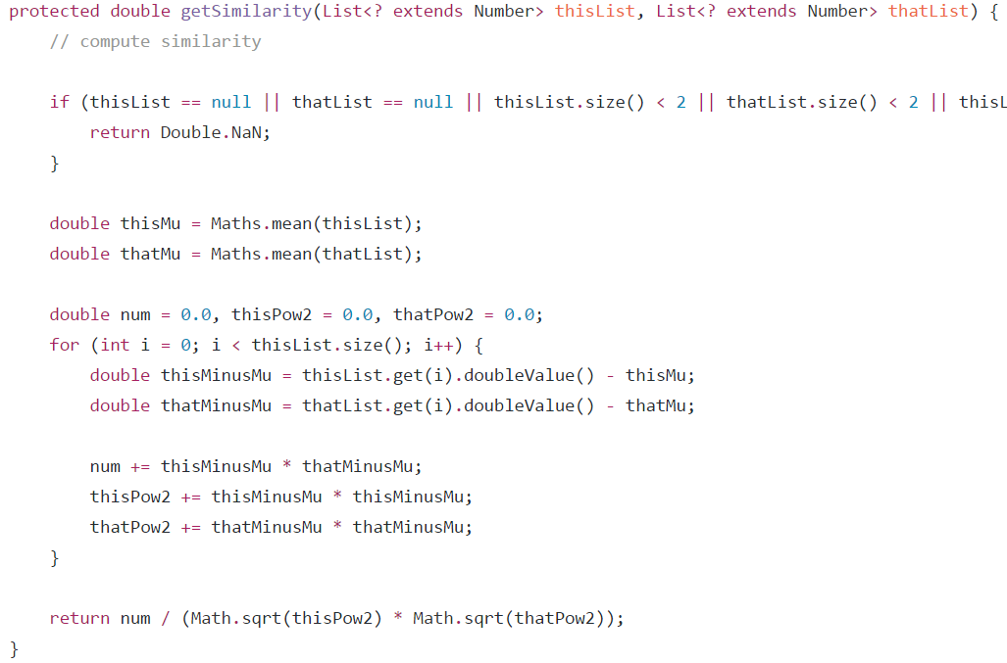
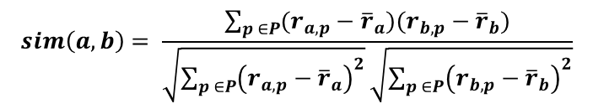
Implementations in LibRec 2.0
PCCSimilarity
$$sim\left(a,b\right)= \frac{\sum_{p ∈P}{(r_{a,p}−{\overline{r}}_{a})(r_{b,p}−{\overline{r}}_{b})}}{\sqrt{\sum_{p ∈P}{{\left(r_{a,p}−{\overline{r}}_{a}\right)}^{2}}}\sqrt{\sum_{p ∈P}{{\left(r_{b,p}−{\overline{r}}_{b}\right)}^{2}}}}$$

Slide 31
Distance-based Similarities
Part III

Slide 32
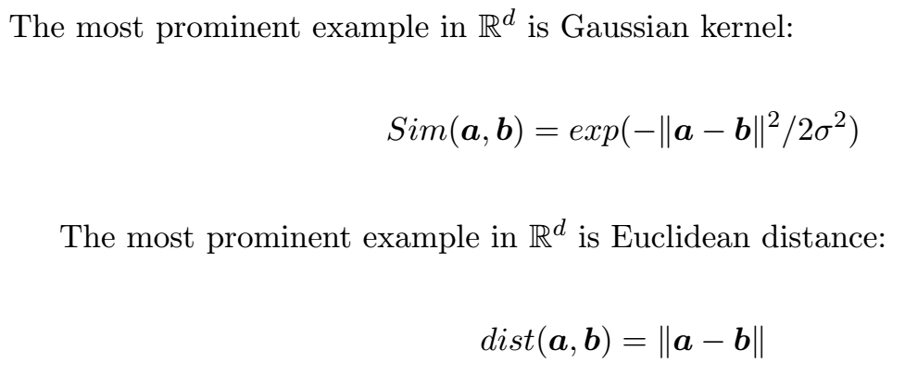
Gaussian Kernel

Slide 33
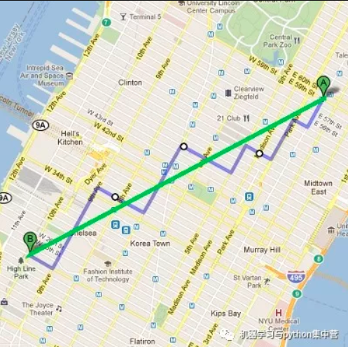
Manhattan Distance

Slide 34

Chebyshev distance
Notes:
数学上，切比雪夫距离是将2个点之间的距离定义为其各坐标数值差的最大值。

Slide 35


Mean Squared Distance (MSD)
Rating distance between two items:
Item Similarity is defined by:

Slide 36
Set-based Similarities
Jaccard Index

Slide 37

Jaccard Index
Jaccard Index (for binary data)
$$Sim\left(X, Y\right)=\frac{|X∩Y|}{|X∪Y|}$$
 | Item1 | Item2 | Item3 | Item4 | Item5
Alice | 1 | 0 | 1 | 1 | ?
User1 | 1 | 1 | 0 | 1 | 1
User2 | 1 | 0 | 1 | 1 | 1
User3 | 0 | 1 | 1 | 1 | 1
User4 | 1 | 1 | 1 | 0 | 1

Slide 38
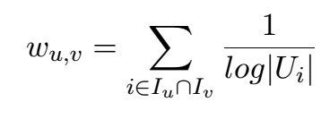
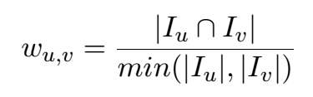
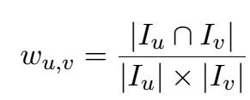
More Index Formula
Adamic-Adar Index
Hub Promoted Index
Leicht-Holme-Newman Index

Slide 39
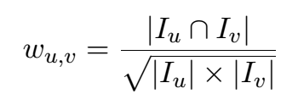
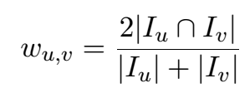
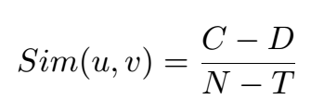
More Index Formula (2)
Salton Index
Searensen Index
Concordance Similarity
Notes:
C: concordant; D: discordant; T: tied; N: the number of rate-able items.

Slide 40
Link-based Similarities
Part III

Slide 41
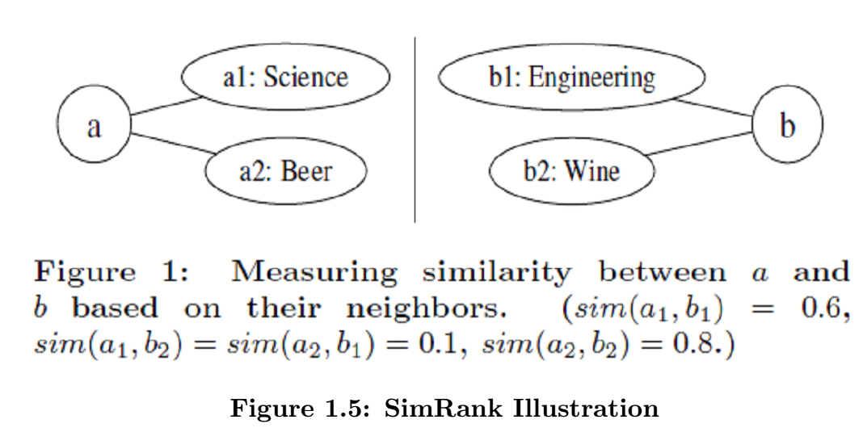
SimRank

Slide 42
Significance Weight
See the attachment (Pages 37-40)

Slide 43
Bayesian Similarity
Part III

Slide 44
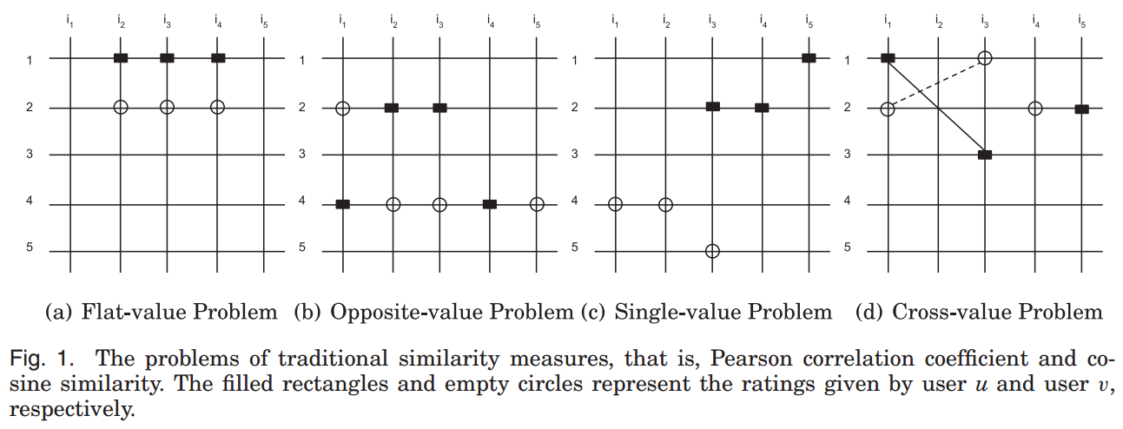
Similarity measure research
Existing similarity problems
G. Guo, et al., A Novel Evidence-based Bayesian Similarity Measure for Recommender Systems, TWEB 2016.

Slide 45
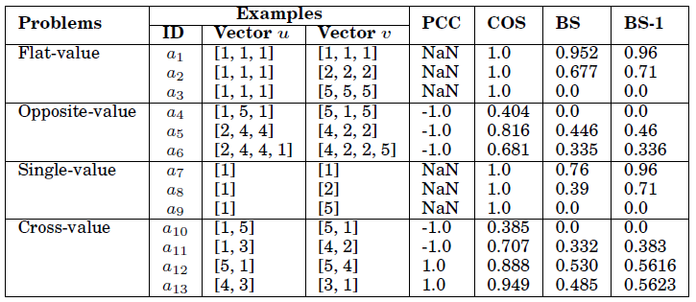
Similarity measure research (2)
Existing similarity problems
G. Guo, J. Zhang, N. Yorke-Smith, A Novel Bayesian Similarity Measure for Recommender Systems, IJCAI 2013.
Notes:
Similarity measure matters:
Identify similar users
Weigh their ratings for prediction

Slide 46
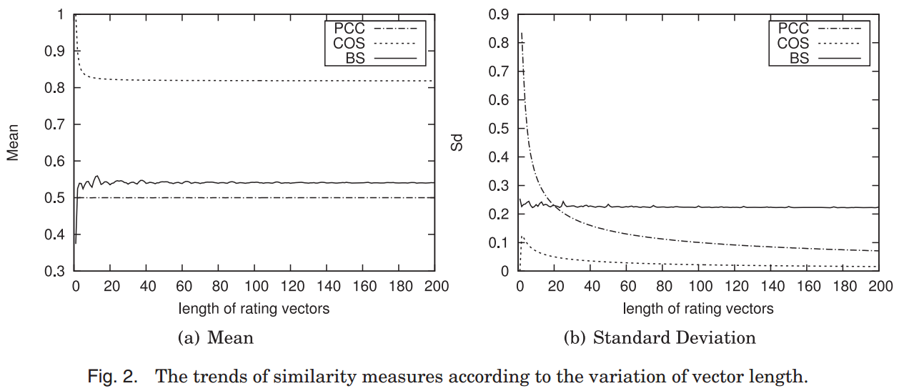
Similarity measure research (3)
Analysis of similarity measures
G. Guo, et al., A Novel Evidence-based Bayesian Similarity Measure for Recommender Systems, TWEB 2016.

Slide 47
Similarity measure research (4)
Traditional measures:
Only consider the directions of rating vectors, but ignore the length of rating vectors
Bayesian similarity measure
Both direction and length considered
Can better handle data sparsity by Bayesian theorem
Basic assumption:
Rating pairs are not equally important for similarity computation
Three evidence weight factors:
Rating consistency
Gaussian singularity
Rating semantics
G. Guo, et al., A Novel Evidence-based Bayesian Similarity Measure for Recommender Systems, TWEB 2016.

Slide 48
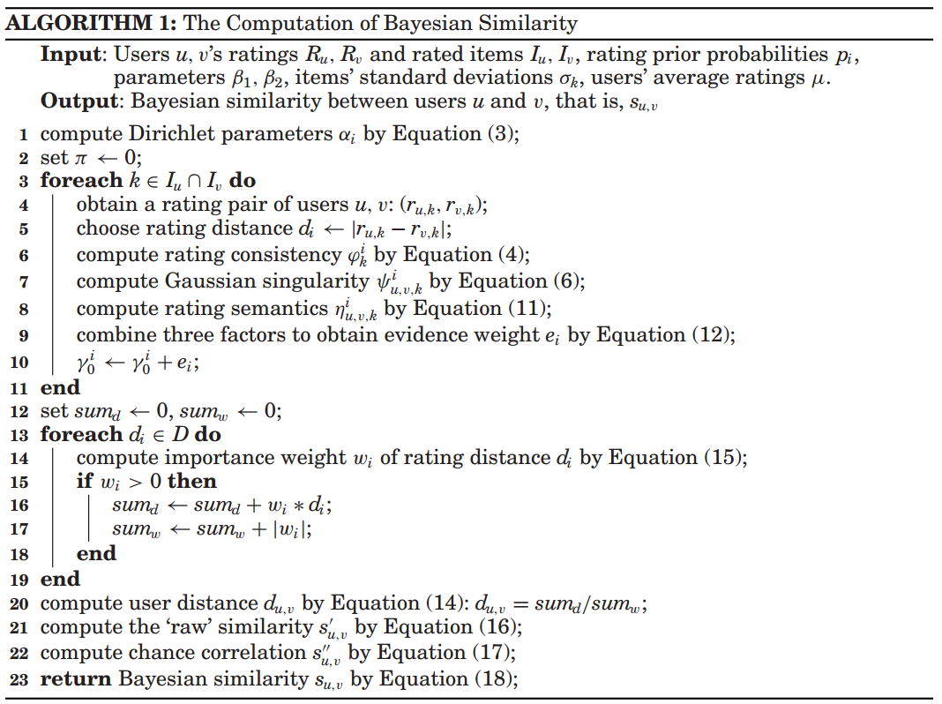
Similarity measure research (5)

Slide 49
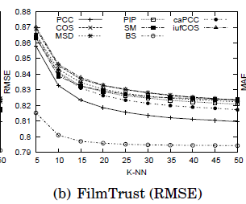
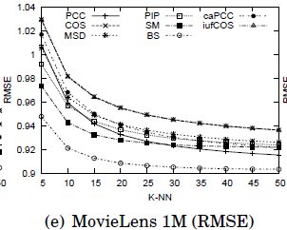
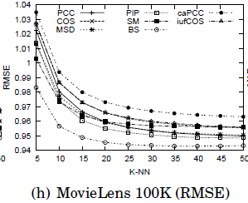
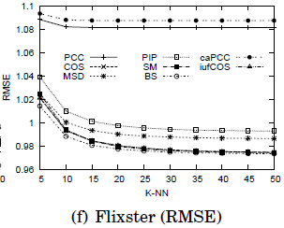
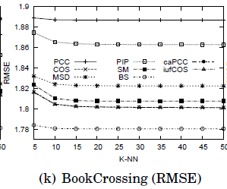
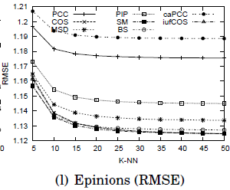
Similarity measure research (6)

Slide 50
What if multi-criteria ratings?
Multi-criteria ratings
Ratings in multiple dimensions
Hotel: room service, wifi, bath, air con, etc.
Q: How to compute user/item similarity?

